Slide 1


QuickSync: Improving Synchronization Efficiency for Mobile Cloud Storage Services
Yong Cui, Zeqi Lai, Xin Wang*, Ningwei Dai, Congcong Miao
Tsinghua University
Stony Brook University*

Slide 2
Outline
Background
Measurement & Analysis
Design & Implementation
Evaluation
Conclusion

Slide 3
Outline
Background
Measurement & Analysis
Design & Implementation
Evaluation
Conclusion

Slide 4



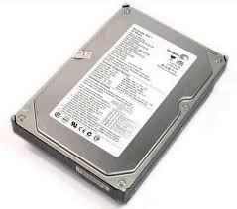
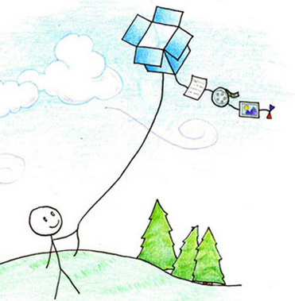


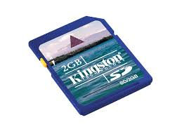
The way we store data…

Slide 5
Mobile Cloud Storage Services (MCSS)
New data entrance
  Numerous providers: Dropbox, Google Drive, OneDrive …
  Large user base: Dropbox has more than 300 million users
  More and more mobile devices/data: MCSS helps to manage fragmented data across multiple devices
  Promising benefit
  Storing, sharing, synchronizing data from anywhere, on any device, at anytime via ubiquitous cellular/Wi-Fi networks
  Sync efficiency is one of the most important performance metric of MCSS.

Slide 6
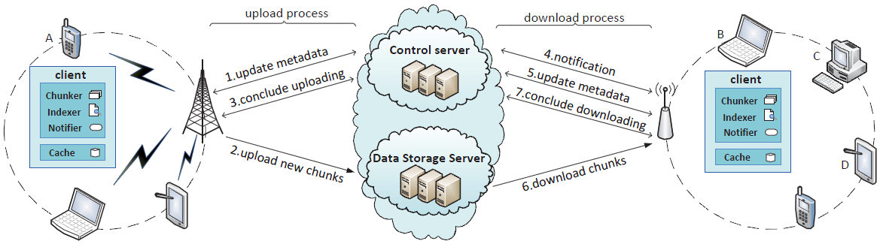
Architecture & Capabilities of MCSS
Architecture
  Control server: metadata management
  Storage server: contents

Slide 7
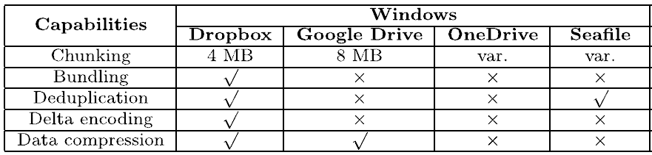
Architecture & Capabilities of MCSS
Key capabilities
  Chunking: splitting a content into a certain size data unit
  Bundling: multiple small chunks as a single chunk
  Deduplication: avoiding the retransmission of content already available in the cloud
  Delta-encoding: only transmitting the modified portion of a file

Slide 8
Can data be synchronized efficiently?
Ideal
  These capabilities can help MCSS to efficiently synchronize our data in mobile/wireless environments (higher delay & intermittent connections)
  Reality
  Sync efficiency is still far from being satisfactory. Sometimes the sync time is much longer than expected!
  Challenges of improving sync efficiency
  Close source & encrypted traffic—hard to identify the root cause
  Proper adaption of storage techniques & network conditions

Slide 9
Aim of our work
  We identify, analyze and address the sync inefficiency problem of modern mobile cloud storage services.

Slide 10
Outline
Background
Measurement & Analysis
Design & Implementation
Evaluation
Conclusion

Slide 11
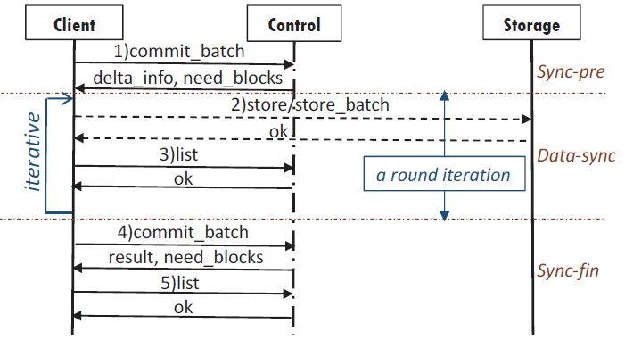
Root cause analysis
Pinning down the sync protocol
  Methodology: network trace analysis & decryption
  Three sync stages: sync preparation, data sync, sync finish
  In-depth analysis: hijack SSL socket of Dropbox

Slide 12
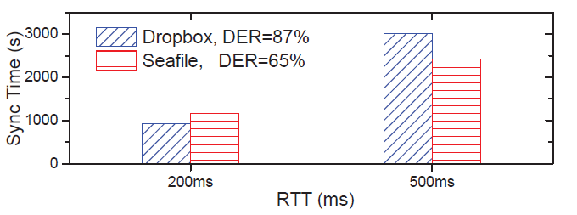
Identifying the sync inefficiency problem
Low DER not equal to efficiency
  DER: deduplicated file size/the original file size
  Backup user data: Seafile eliminates more redundancy
  Lower DER may not always make sync efficient!
  Network condition should be considered

Slide 13
Root cause analysis
Why less data cost more time?
  Chunking in deduplication: effectiveness-time trade-off
  Fixed-size is efficient in good network conditions
  Aggressive chunking helps in high delay environments

Slide 14
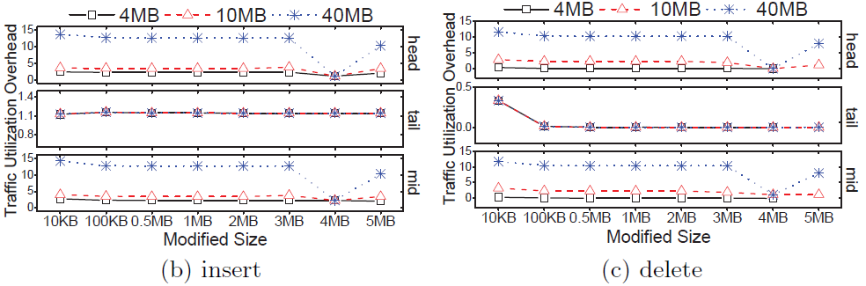
Identifying the sync inefficiency problem
Failure of incremental sync
  TUO: generated traffic size /expected traffic size
  3 operations (flip bits, insert, delete) over continuous w bytes at the head, end or random position of the test file
  Incremental sync fails for certain operations
TUO>10!

Slide 15
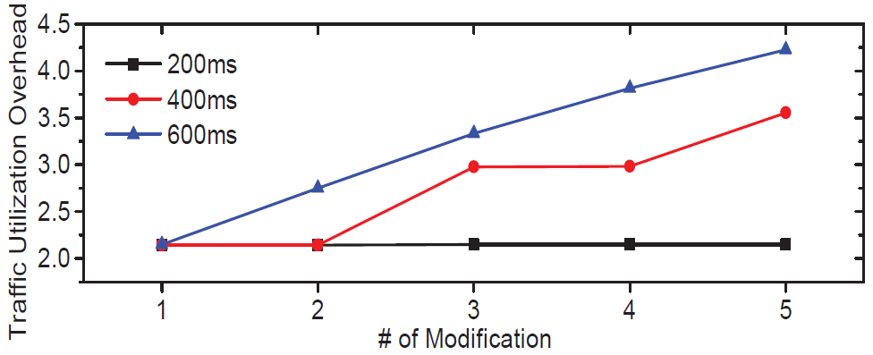
Identifying the sync inefficiency problem
Failure of incremental sync
  Sync traffic of performing modification on files in the middle of the transmissions to the cloud
  Incremental sync fails in certain network conditions

Slide 16
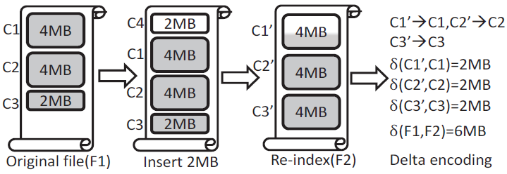
Root cause analysis
  Why the incremental sync fails
  A file is split into chunks
  Delta-encoding algorithm is performed between 2 mapped chunks
  The metadata is updated after chunks are successfully uploaded. A chunk in the middle of sync cannot be used for delta-encoding.

Slide 17
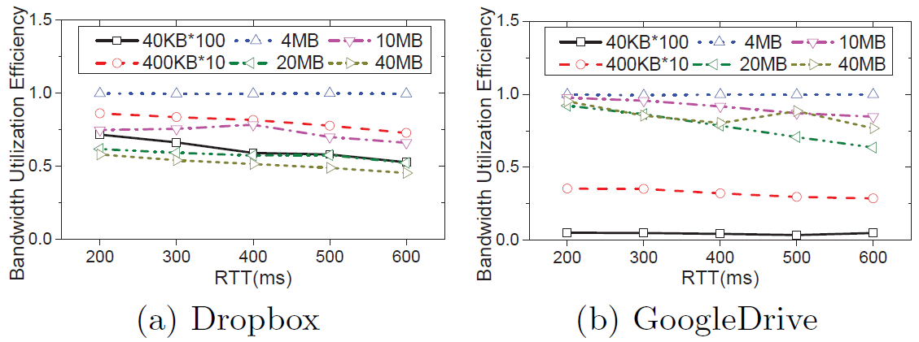
Identifying the sync inefficiency problem
Bandwidth inefficiency
  BUE: measured throughput / theoretical TCP bandwidth
  Synchronize files differing in size in wireless networks
  Sync is not efficient for multiple small files in high RTT conditions

Slide 18
Root cause analysis
Why the bandwidth utilization decreases
  The client has to wait for an acknowledgement from the server before transferring the next chunk
  Iterative sync: up to 4 concurrent TCP connections, several connections are idle between two iterations
  Too many new connections and throughput is limited by slow start

Slide 19
Outline
Background
Measurement & Analysis
Design & Implementation
Evaluation
Conclusion

Slide 20
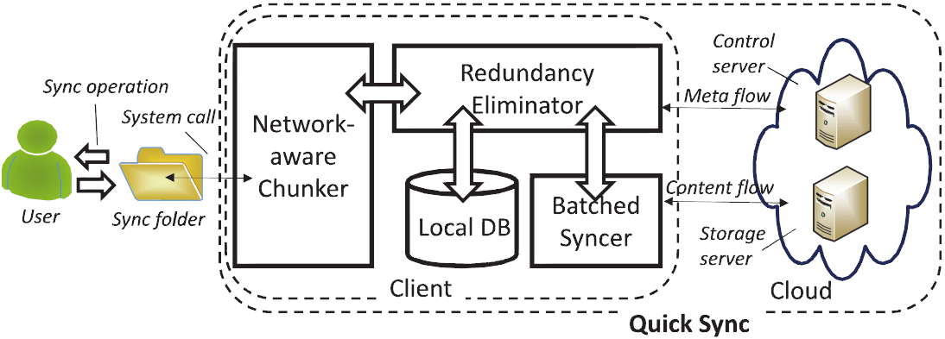
QuickSync: improving sync efficiency
System overview
  We propose a network-aware deduplication technique to identify redundant data
  We design an improved incremental sync approach that correctly performs delta-encoding between 2 similar chunks to reduce sync traffic
  We adopt a delayed-batched acknowledgement to improve the bandwidth utilization

Slide 21

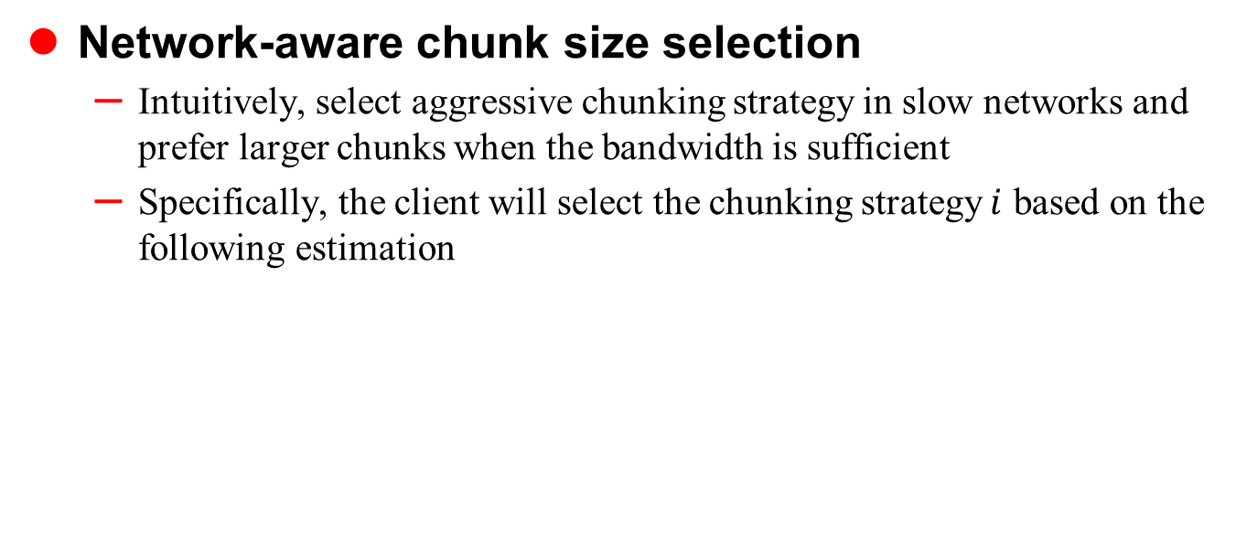
Design detail: Network-aware Chunker
Network-aware chunk size selection
  Intuitively, select aggressive chunking strategy in slow networks and prefer larger chunks when the bandwidth is sufficient
  Specifically, the client will select the chunking strategy $i$ based on the following estimation
Data size
Deduplication ratio
Computation time
Segment_size*cwnd/RTT

Slide 22
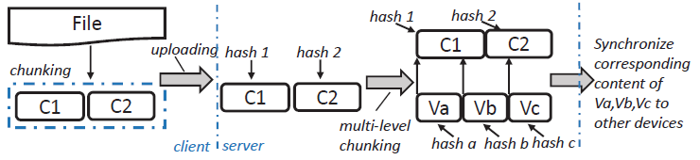
Design detail: Network-aware Chunker
Virtual chunks in the server
  Multi-granularity deduplication
  No need to store all metadata and chunks
  Virtual chunk only stores the offset and length which can be used to generated the pointers to the content

Slide 23
Design detail: Redundancy eliminator
Two-step sketch-based mapping
  Hash match: two chunks are identical
  Sketch match: two chunks are similar
  Performing delta-encoding between two chunks with the same sketch
Buffering uncompleted chunks
  Chunks waiting to be uploaded or performed delta-encoding are temporarily buffered in local device
  Incremental sync works in the middle of a sync process

Slide 24
Design detail: Batched Syncer
Batched transmission
  defer the app-layer acknowledgement to the end of the sync process, and actively check the un-acknowledged chunks upon the connection interruption
  check will be triggered: when the client captures a network exception, or time out
  Reusing existing network connections
  Reuses the storage connection to transfer multiple chunks, avoiding the overhead of duplicate TCP/SSL handshakes

Slide 25
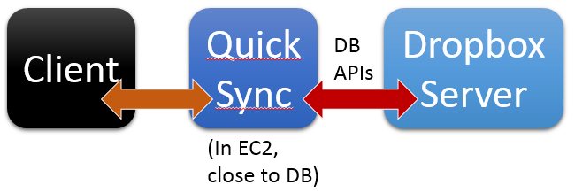
System implementation
Implementation over Dropbox
  Unable to directly implement on DB
  Solution: a proxy implementation close to Dropbox server
  Implementation over Seafile
  The proxy itself adds more overhead and degrades performance
  Full implementation with Seafile, an open source cloud storage service

Slide 26
Outline
Background
Measurement & Analysis
Design & Implementation
Evaluation
Conclusion

Slide 27
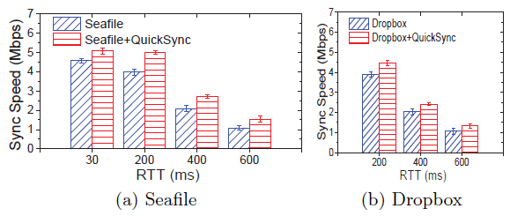
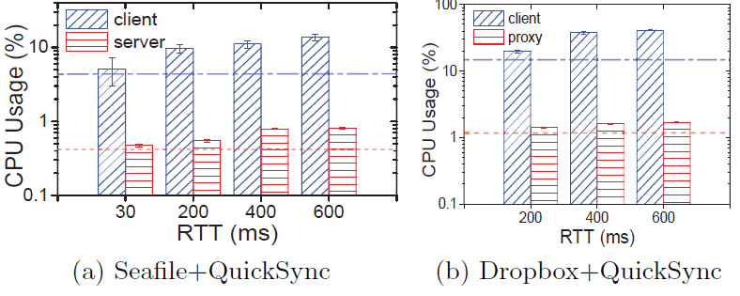
Impact of the Network-aware Chunker
Setup
  Data set: 200GB backup
  RTT setting: 30~600ms
  Performance
  Up to 31% sync speed improvement
  CPU overhead
  Client: <12.3%
  Server: <0.5% (per user)

Slide 28
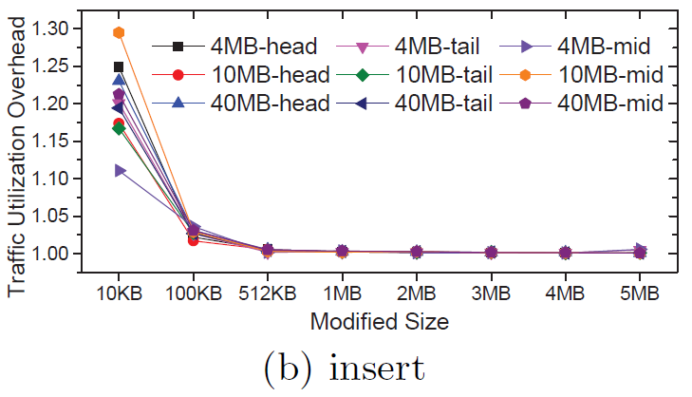
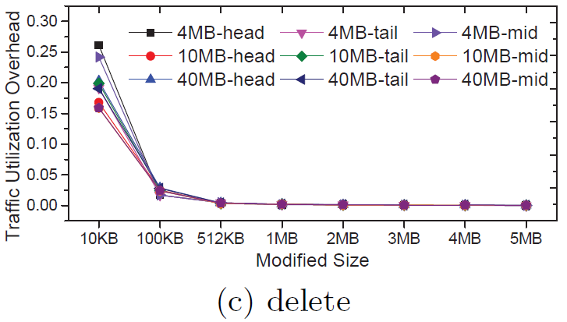
Impact of the Redundancy Eliminator
Setup & Results
  Conduct the same set of experiments for modify operation as shown in our measurement
  TUO results are close to 1 (flip & insert) or 0 (delete)
  QuickSync only synchronizes new contents under arbitrary number of modifications and any RTT

Slide 29
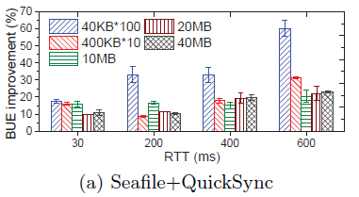
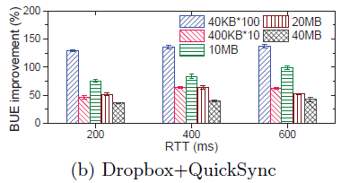
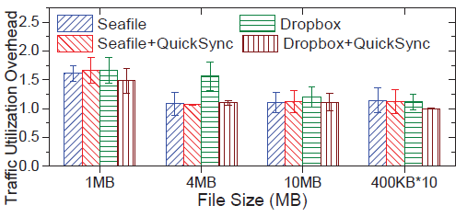
Impact of the Batched Syncer
Setup
  Uploading files differing in size
  Performance
  Up to 61%, more obvious in high RTT environment
  Overhead for exception recovery
  Less than Seafile and Dropbox
  TUO<1.5

Slide 30
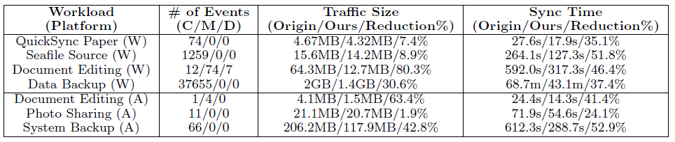
Performance of the Integrated system
Setup
  Practical sync workloads on Windows & Android
  Traffic size reduction
  Up to 80.3%/63.4% on Windows/Android
  Sync time reduction
  Up to 51.8%/52.9% on Windows/Android

Slide 31
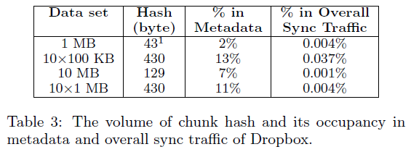
Server-side storage overhead
Server-side overhead: measurement & analysis
  Using smaller chunks will increase the metadata overhead
  The additional overhead of QuickSync is only a very small fraction of the overall storage cost
very small fraction

Slide 32
Outline
Background
Measurement & Analysis
Design & Implementation
Evaluation
Conclusion

Slide 33
Interests from IETF93
Our work in IETF
  We have made a presentation to introduce our work in this paper in the appsawg session of IETF 93, Prague, in July 2015
  Standard sync protocol
  APIs will be unnecessary or at least simplified
  Sync among different services is available
  Easy to improve Internet storage services
  Viewpoint from IETF: good topic for a BOF
  Our mail list: storagesync@ietf.org

Slide 34
Conclusion
Sync Inefficiency & Root cause analysis
  Low DER Not Equal to Efficiency
  Failure of Incremental Sync
  Bandwidth Inefficiency
  Cause: limitations of the sync protocol and the distributed architecture
  QuickSync: design, implementation, evaluation
  Three key techniques
  Implementation over Dropbox & Seafile
  Up to 52.9% sync time reduction

Slide 35
Questions?

Slide 36
Related work
Measurement study
  Measurement & performance comparison for enterprise cloud storage service [IMC’10]
  Measurement & benchmarking for personal cloud storage [IMC’12] [IMC’13]
  Sync traffic waste [IMC’14]
  Our measurement identify and reveal the root cause of sync inefficiency in wireless networks

Slide 37
Related work
System design
  Enterprise data backup system [FAST’ 14]
  Data consistency in sync services [FAST’ 14]
  Reducing sync overhead [Middleware’ 13]
  QuickSync focuses on performance in wireless networks, and the consistency study is complemented with our work

Slide 38
Related work
CDC and delta encoding
  Content defined chunking [FAST’ 08] [FAST’ 12] [INFOCOM’ 14] [SIGCOMM’ 00]
  Delta encoding: rsync, https://rsync.samba.org/
  QuickSync utilizes CDC addressing for a unique purpose, adaptively selecting the optimized chunk size to achieve sync efficiency
  We also improve the delta encoding and address the limitation in MCSS

